Slide 1
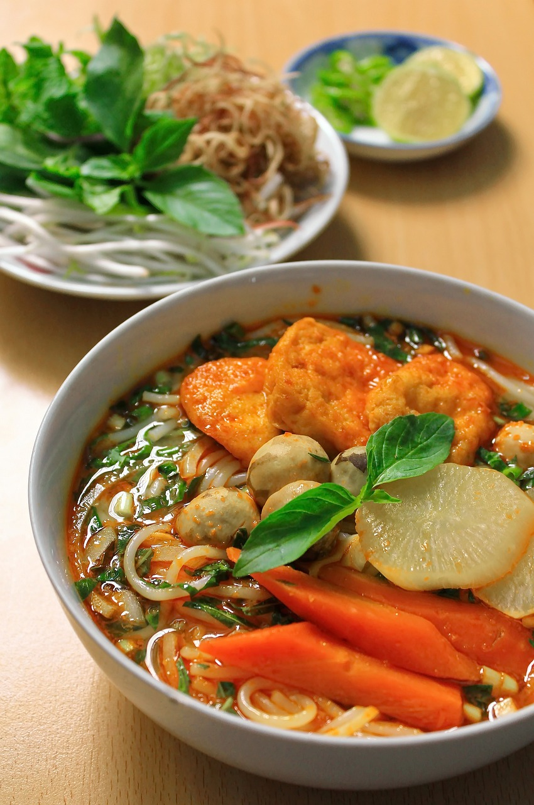
Disadvantages of noodles

Slide 3

What are of our health when we eat too much noodle?
Heart disease

Slide 4
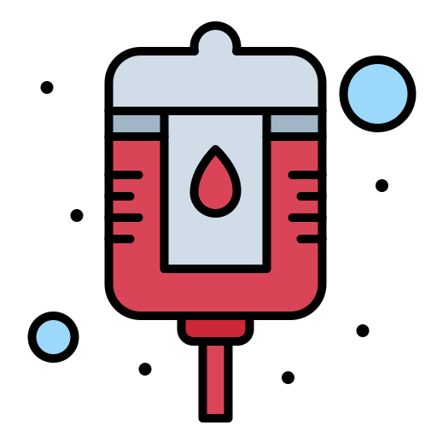
What are of our health when we eat too much noodle?
Heart disease
High Blood Pressure

Slide 5
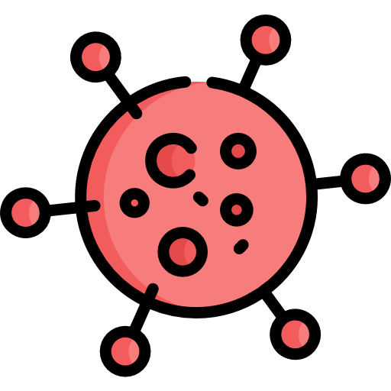
What are of our health when we eat too much noodle?
Heart disease
High Blood Pressure
Causes cancer

Slide 6
Conclusion

